Slide 1
Rodents
Day 1

Slide 2
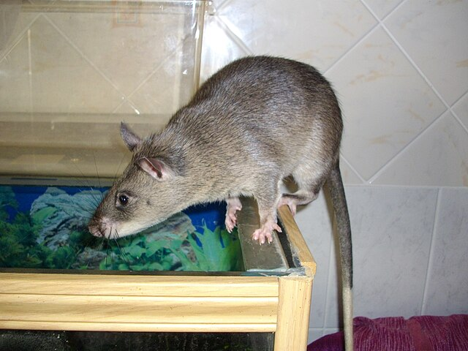
Do Now
Answer our project’s driving question:
Why do rodents get into our building and what can we do about this?
Image: Laëtitia Dudous
Creative Commons Attribution-Share Alike 3.0

Slide 3
Products
Individual:
A report on the current state of rodent management around our school.
Group:
Develop a School Rodent Management Plan.
After we finish, we will present it to school leadership.

Slide 4
Vocab
Commensal Pest
An organism that has adapted to live exclusively in human habitats, finding all the food, water, and shelter they need to survive.
For example, a house mouse can live in our homes without needing access to the outside. A squirrel, however, would not be able to survive without going outside.
Similarly, house mice could live on a space station alongside humans, but a squirrel couldn’t.

Slide 5
Group Work: Common US Rodents
Pick a Rodent:
Norway Rat / Brown Rat
Roof Rat / Black Rat
House Mouse
Deer Mouse
White-footed Mouse
Meadow Mouse / Vole
Pack Rat
Create an information sheet with:
Drawing of rodent with identification traits labeled (size, color, etc.)
Scientific name
Commensal (yes / no)
Diseases carried
Diet
Footprints (tracks)
Appearance of feces (size, shape)

Slide 6
Gallery Walk: take notes on each of our rodents.
This information will be essential for inspecting our school and writing our School Integrated Pest Management Plan.

