Slide 1
Mouse Food Web and Secondary Poisoning
Day 10

Slide 2
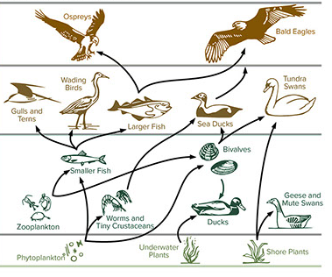

DO NOW
Write down two things you see and two things you wonder about this diagram.
Image source: https://serpmedia.org/scigen/l1.3d.html

Slide 3
Today’s Question
What is the food web for a mouse and how do rodenticides affect it?

Slide 4
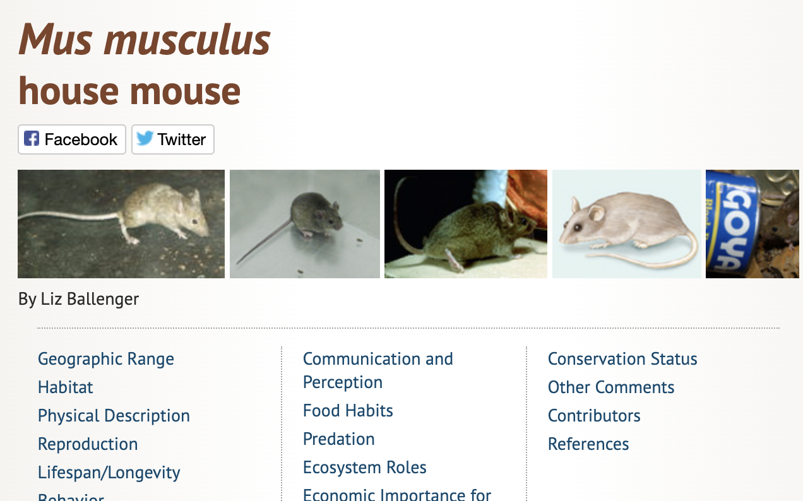
Today, we will make a food web for mice using Animal Diversity Web https://animaldiversity.org/accounts/Mus_musculus/

Slide 5
Use Animal Diversity Web to discover:
What plants do mice feed upon?
What are two predators for mice?
What feeds on those predators?
What feeds on the predators of the predators?
https://animaldiversity.org/accounts/Mus_musculus/

Slide 6
Now, use what you discovered to make a food web for mice. Here is an example food web.
Image source: https://serpmedia.org/scigen/l1.3d.html

Slide 7
