Slide 1
Non-Target Animals
Day 11

Slide 2
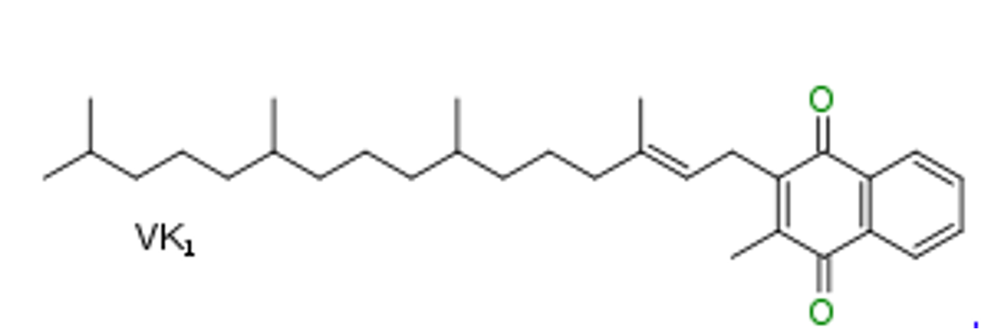
Do Now
Explain how anticoagulants kill rodents.

Slide 3
Today’s Question
What is secondary and tertiary poisoning and how frequently does this happen?

Slide 4
Non-Target Animal
A non-target animal is any animal that might feed upon a poison aside from the actual intended target.
For example, if you put out a poison to kill mice, the mice are the target.
What are some examples of other organisms that might get sick from the mouse bait? These are non-targets.

Slide 5
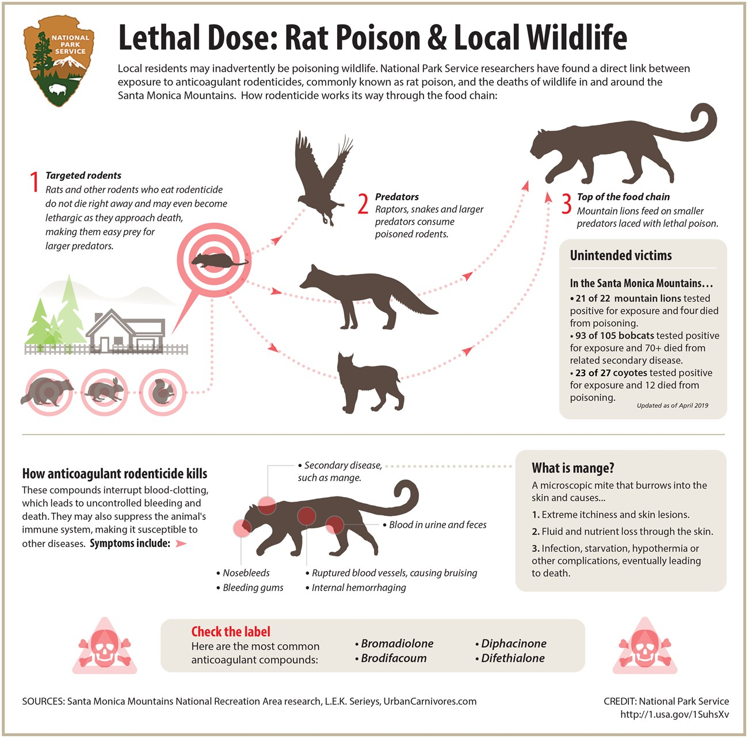
Primary, Secondary, and Tertiary poisoning
Read the definitions of Primary, Secondary, and Tertiary poisoning on your worksheet, then label the drawing on the back with each term.

Slide 6
Dane County Humane Society Rescue Report
Read the Dane County Humane Society Rescue Report. What evidence is there that hawks in Wisconsin have been poisoned with rodenticides? Also include if this is primary, secondary, or tertiary poisoning.

