Slide 1
Control Measures
Day 12

Slide 2
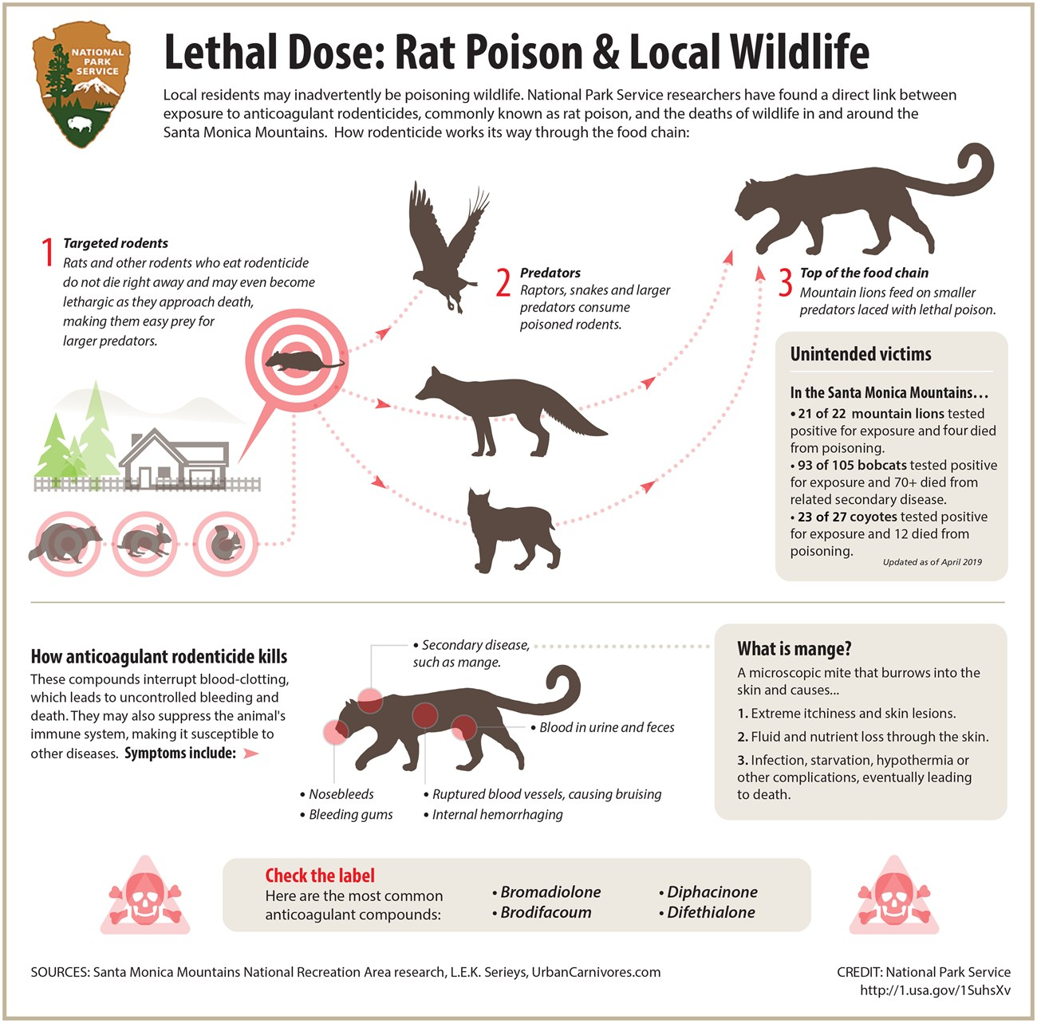
Do Now
Imagine you wanted to use a rodenticide to kill mice around your home. What could you do to help reduce or stop secondary poisoning from occurring?

Slide 3
Today’s Question
How do we use baits and traps safely and most effectively? What options are there for traps?

Slide 4
New York School IPM video on traps and baits (6:42)
https://youtu.be/gHXn7QwL-Ag?si=5lRCHfCXMmRgecNn

Slide 5
Rodent Bait
What risk does this pose at our school?
How can we use it safely? Or, should we not recommend its use, and if so, why not?

Slide 6
Glue Boards
What risk do glue boards pose at our school?
How can we use glue boards safely? Or, should we not recommend its use, and if so, why not?

Slide 7
Snap Traps
What risk do snap traps pose at our school?
How can we use snap traps safely? Or, should we not recommend its use, and if so, why not?

