Slide 1
Exclusion
Day 13

Slide 2
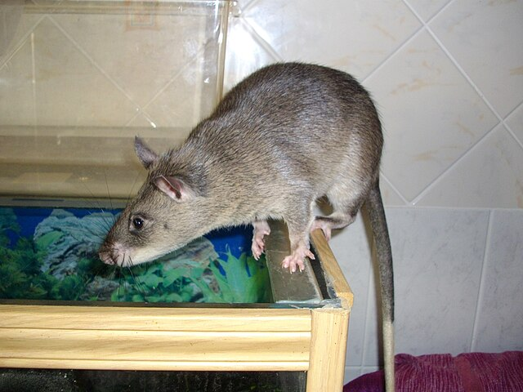
Do Now
Based upon our prior class and your own experience, if you had rodents come into your home, how would you get rid of them? Why this method?
Image: Laëtitia Dudous
Creative Commons Attribution-Share Alike 3.0

Slide 3
Today’s Question
How can we keep rodents out of structures?

Slide 4
Brainstorm
What do you think rodents need to survive in a structure?
Come up with a list!

Slide 5
New York School IPM video on “Why do I have Rodents?” (5:06)
Let’s watch this video to check out work. While watching the video, add to your list of what rodents need to survive in a structure.
Note: also include what rodents look for in structures (the reasons they come inside).
https://youtu.be/pug3kOQIbrY?si=crX7IV1zhR0yimke

Slide 6
Rodent Survival
Rodents primarily need three things to survive in a structure:
Food
Water
Shelter (a safe place to nest)
There’s other things that can be helpful, like heat sources, but these three are the top items.

Slide 7
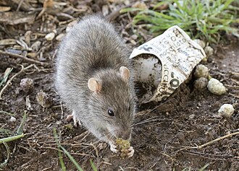
Rodent Survival
If we deny rodents food, water, and shelter, then the fewer traps and poisons need to be used.
Creative Commons Attribution-Share Alike 4.0 International
Zeynel Cebeci
https://commons.wikimedia.org/wiki/File:Rattus_norvegicus_-_Brown_rat_01.jpg

Slide 8
Another key to rodent control is to keep rodents from being able to get into a structure and to not allow them to easily move around from room to room.
Let’s watch another video on this.
Watch: New York State IPM video on exclusion (5:12)
https://youtu.be/gXJwW5Iarn0?si=U_gwefz0L4g9bsCa

Slide 9
Exclusion Products
Now let’s look at some common exclusion products and how they work.

Slide 10
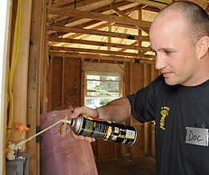
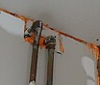
Expanding Foam
Pros:
- Easy to apply.
Cons:
- Rodents can easily chew through it.
Many people try to use expanding foam to seal up openings, but it is not a good solution.
Photos: Public Domain, Wikimedia Commons

Slide 11
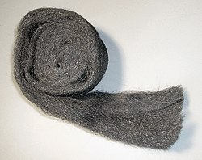
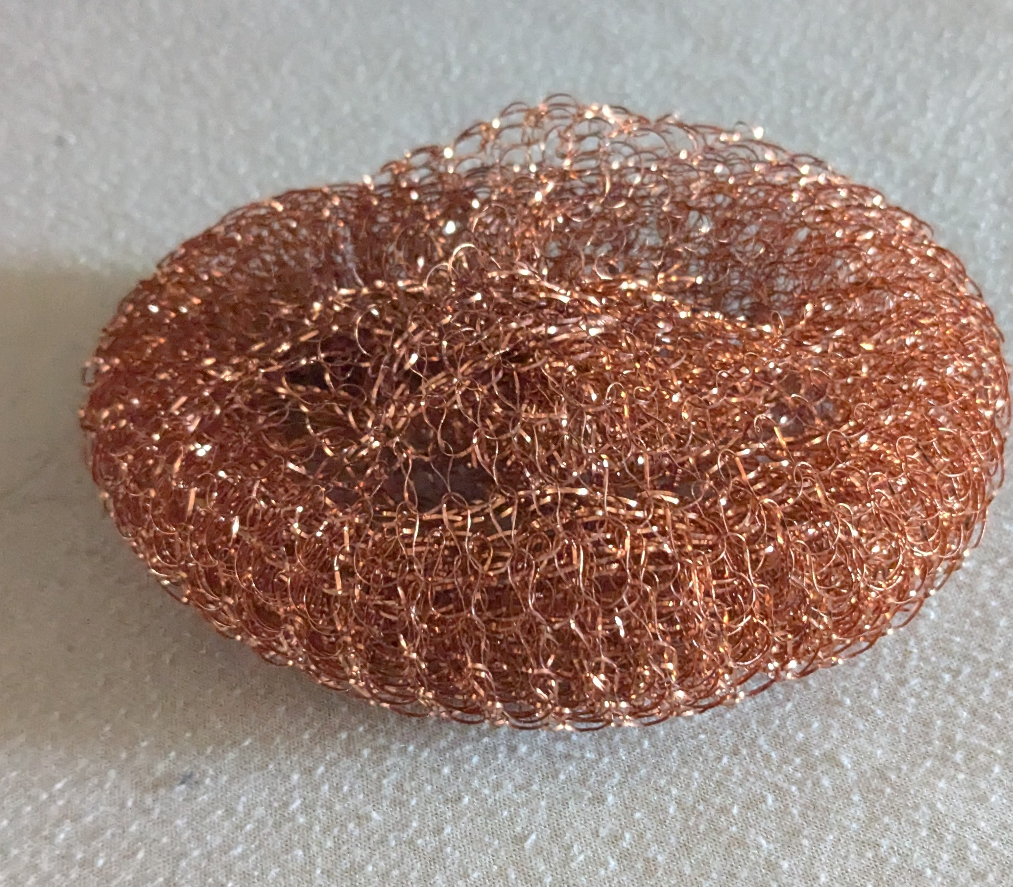
Steel Wool / Copper Mesh
Metal can be pushed into small openings in walls. Rodents can’t gnaw on these and they effectively seal openings.
Pros:
- Easy to apply to use.
Cons:
- Steel rusts and falls out. Use copper instead.
- Only good for smaller openings.
Photos: Steel Wool by Johan, Creative Commons Attribution-Share Alike 3.0, Wikimedia Commons; Copper Mesh by Ted Snyder

Slide 12
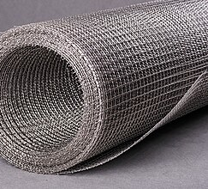

Sheet Metal / Wire Mesh
Larger openings can be covered with sheet metal or wire mesh. It needs to be screwed in to cover the opening. The openings in wire mesh need to be small enough that rodents can’t get in.
Pros:
- Easily covered larger openings.
- Can’t be gnawed through.
Cons:
- Takes more skill to apply than other products.
Photos: Wire Mesh by Roman Fursa, Creative Commons Attribution-Share Alike 4.0, Wikimedia Commons, Sheet Metal, Public Domain

Slide 13
Exclusion Products
All of these are products that we can recommend using around our building to keep rodents out.
During our inspection, did we see any place where they could be used?

