Slide 1
IPM Plan
Day 15

Slide 2
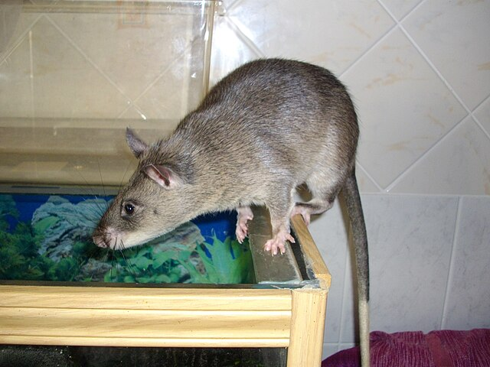
Do Now
What is the most important idea that we have learned in this project?
Image: Laëtitia Dudous
Creative Commons Attribution-Share Alike 3.0

Slide 3
Today’s Question
What is IPM and why is an IPM plan important?

Slide 4
What is IPM?
https://youtu.be/qMr3m-HUdAw?si=hKFaYfjpLLyafpLU

Slide 5
What is IPM?
IPM or Integrated Pest Management is using multiple ways to control pests instead of just relying upon pesticides (poisons) alone.

Slide 6
What is IPM?
For example, if you just put out rodenticide for a mouse problem, that isn’t IPM.
If you just used roach spray on a cockroach issue, that isn’t IPM, either.

Slide 7
What is IPM?
Instead, to control rodents, figure out what their entry point is and plug it up.
Then, use traps to kill them, if possible.
That would be IPM. It’s also the most effective way of controlling rodents.

Slide 8
What is IPM?
If you have cockroaches, first make sure the place is clean. Spilled food and messes provide a feast to cockroaches.
Fix any leaky pipes that would give them a water source.
Then, when you use a poison to control the cockroaches, it will work better because you’ve stressed them through denying them food and water.
That’s IPM, and it’s more effective than just spraying.

Slide 9
Writing our IPM Plan
Now we’re going to write an IPM Plan for our school, focused upon rodents. Use your notes – this will be based upon everything we’ve learned in this project.
I will pull up the IPM Plan and go over it section by section and assign out who will work on each.

