Slide 1
Rodents
Day 2

Slide 2
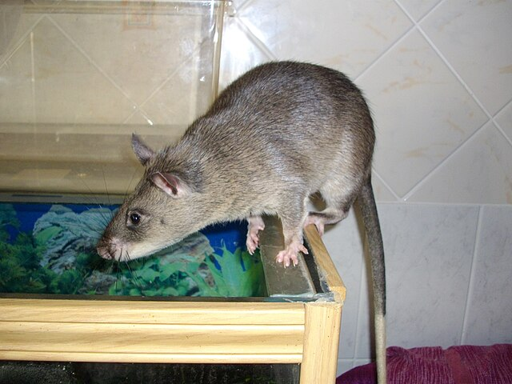
Do Now
How do you know if you have mice or rats in your home?
Answer this on your worksheet for today.
Image: Laëtitia Dudous
Creative Commons Attribution-Share Alike 3.0

Slide 3
Today’s Question
What do we look for in a rodent inspection?
We’ll get started with a short video that will show us what to look for. Be prepared to answer questions about the video on your worksheet.

Slide 4
NY State IPM Video on signs of a rodent infestation (5:10)
https://youtu.be/kP9Pi4W1ewc?si=Mm_0duFl5B--czqu

Slide 5
Building Inspection
Tomorrow we will perform our own building inspection for rodents.
We will look for signs of rodents, like we saw in the video, and any traps, bait, or other evidence of control programs.
We will use a checklist to help us in our inspection and allow us to document what we found.
Our findings will be used throughout the rest of this unit.

Slide 6
What does a rodent inspection look like?
https://youtu.be/stptputfOAA?si=fp6yI-0o_8tQH9tL
Let’s watch an inspector from the City of Evanston, IL perform a rodent inspection (11:46) to see an example of what we will be doing around school tomorrow.

