Slide 1
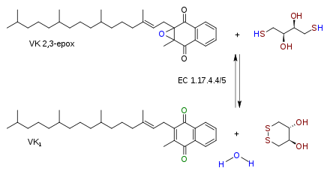
Vitamin K

Slide 2
Vitamin K epoxide

Slide 3
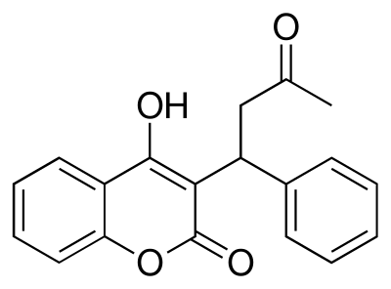
Warfarin

