Slide 1
Rodenticides
Day 6

Slide 2
Do Now
Answer the following questions on your worksheet:
What does blood clotting mean?
What would happen to you if your blood didn’t clot?

Slide 3
Today’s Question
What is an anticoagulant and how does it affect mammals?

Slide 4
Video: Blood, rats and anticoagulants: The story of warfarin
(2:55)
https://youtu.be/OnzF0oJkYe0?si=kIpPb5p-BnG3893u

Slide 5
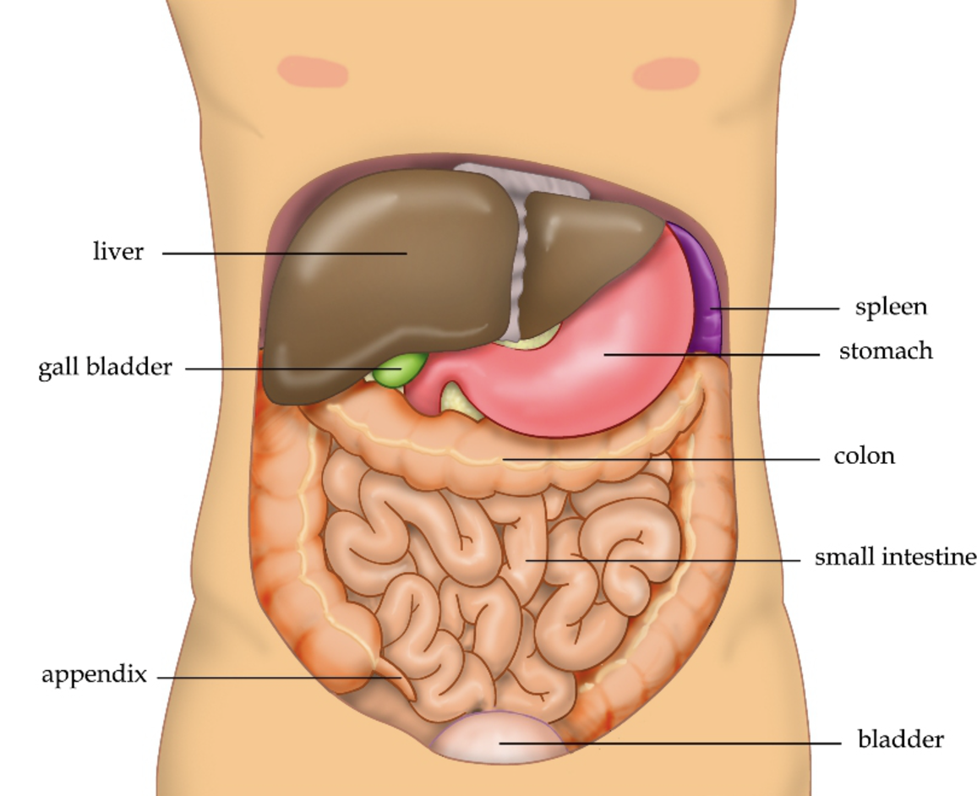
Anticoagulants
Most rodenticides are anticoagulants.
These stop blood from clotting by stopping the body from making key proteins involved in clotting.
Your body uses vitamin K to make these proteins in the liver. Anticoagulants interfere with this process.
Let’s look at how this happens.
Image: Wikipedia, Public Domain

Slide 6
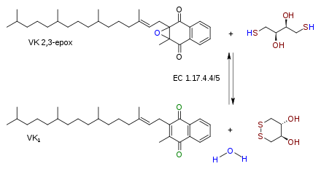
Vitamin K
When your body makes blood clotting proteins, it transforms vitamin K (above) into vitamin K epoxide (below).

Slide 7
Molecular Structures
Each of these lines is called a “bond.” The are how atoms are connected and held together. I’ve circled one bond.

Slide 8
Molecular Structures
You will be assigned either vitamin K, vitamin K epoxide, or warfarin. Make a cardboard model of your molecule.
Scale: We will do an activity with these and they all need to be the same scale. Make each bond 1 ½ inches long.

Slide 9
Vitamin K

Slide 10
Vitamin K epoxide

Slide 11
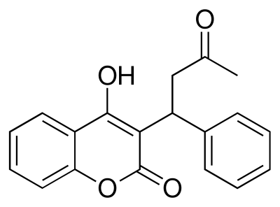
Warfarin

