Slide 1
Rodenticide Mode of Action
Day 9

Slide 2
Do Now
Pick up your cardboard models and get into groups.
Each group must have at least one of the following:
vitamin K
vitamin K epoxide
warfarin

Slide 3
Today’s Question
How do rodenticides work at the biochemical level?

Slide 4
Video: Enzymes and Active Sites (5:46)
https://youtu.be/qgVFkRn8f10?si=QUk5KA249_y5c03D

Slide 5
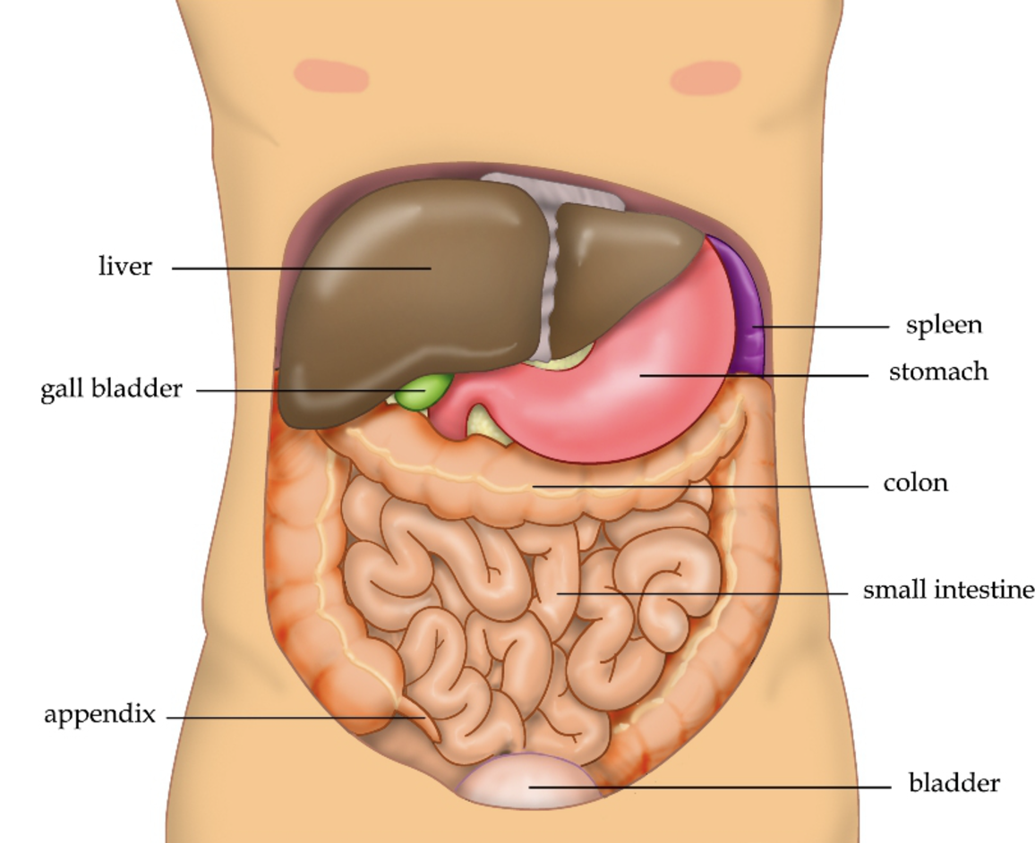
Anticoagulants
Refresher:
Most rodenticides are anticoagulants.
These stop blood from clotting by stopping the body from making key proteins involved in clotting.
Your body uses vitamin K to make these proteins in the liver. Anticoagulants interfere with this process.
Image: Wikipedia, Public Domain

Slide 6
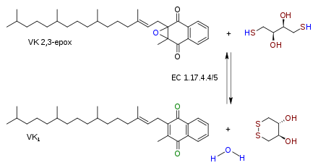
Vitamin K
When your body makes blood clotting proteins, it transforms vitamin K (above) into vitamin K epoxide (below).

Slide 7
Vitamin K
If your body runs out of vitamin K, then it can no longer make those proteins and your blood doesn’t clot.

Slide 8
Vitamin K
So, an enzyme called vitamin K epoxide reductase takes vitamin K epoxide and turns it back into vitamin K.

Slide 9
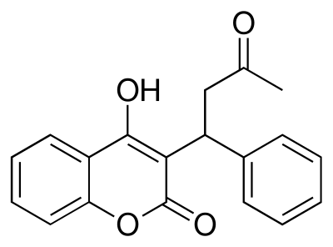
Warfarin
However, if warfarin can get stuck in the active site on vitamin K epoxide reductase, then the enzyme will no longer function.
Remember how, if someone doesn’t produce much lactase, they have problems digesting lactose?
Similarly, warfarin keeps vitamin K epoxide reductase from working, causing problems (bleeding).

Slide 10
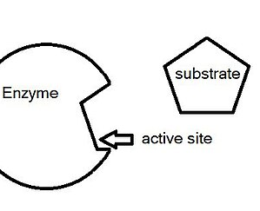
Now, as a group, build vitamin K epoxide reductase
This enzyme should have an active site that your vitamin K epoxide can fit into.
See the example to the right, where the substrate can fit into the active site.
This active site needs to also fit warfarin. Warfarin sits in the active site and prevents vitamin K epoxide from binding.
Afterwards, set up on your table a demonstration of the enzyme converting vitamin K epoxide into vitamin K, then change it to warfarin blocking the enzyme.
Image: Wikipedia, Public Domain

Slide 11
Formative Assessment
Based upon what we learned and your models, explain the process of how blood clotting works and how anticoagulant rodenticides interfere with blood clotting.

