Slide 1
Ant Evolution & Ecology Project

Slide 2
DO NOW
When and where have you seen ants in our school building?
Did the ants cause any problems, such as getting into your food?

Slide 3
Project Question
Ants have evolved to be one of the most successful groups of organisms in many ecosystems, which is also why they are such an important pest species. How can we, with an understanding of their traits, reduce the problems they cause in and around our school building?

Slide 4
End Product
Our goal is to come up with a plan on how we can better control the ants that show up in our building. This is called an Integrated Pest Management or IPM Plan.
In order to write this plan, we need to develop a deep understanding of ants.

Slide 5
Today’s Question
What makes an organism an ant?
Let’s look at some photos.

Slide 6
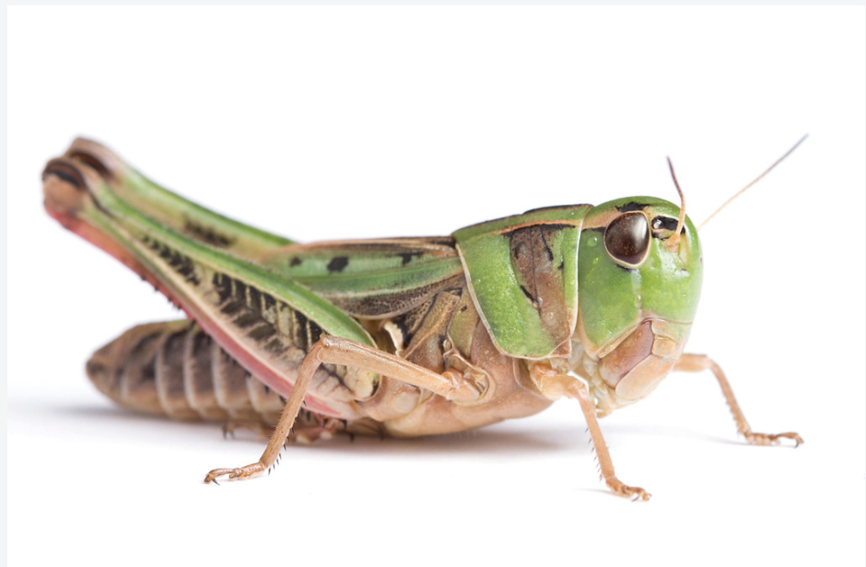
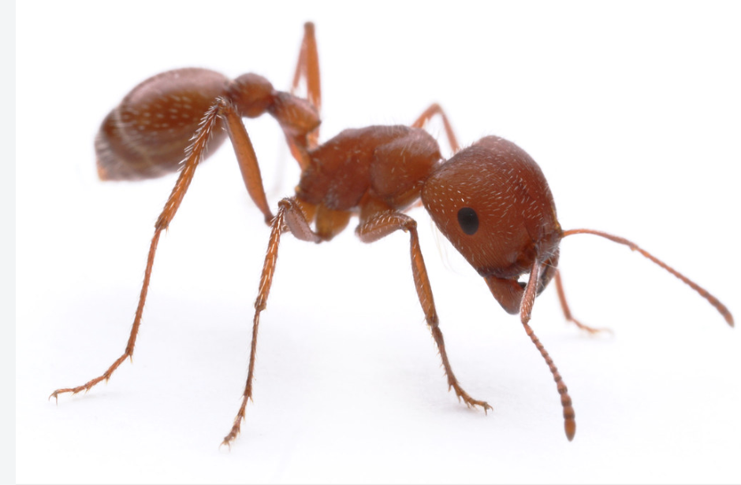
Which one is an ant? How can you tell?
A. B.

Slide 7
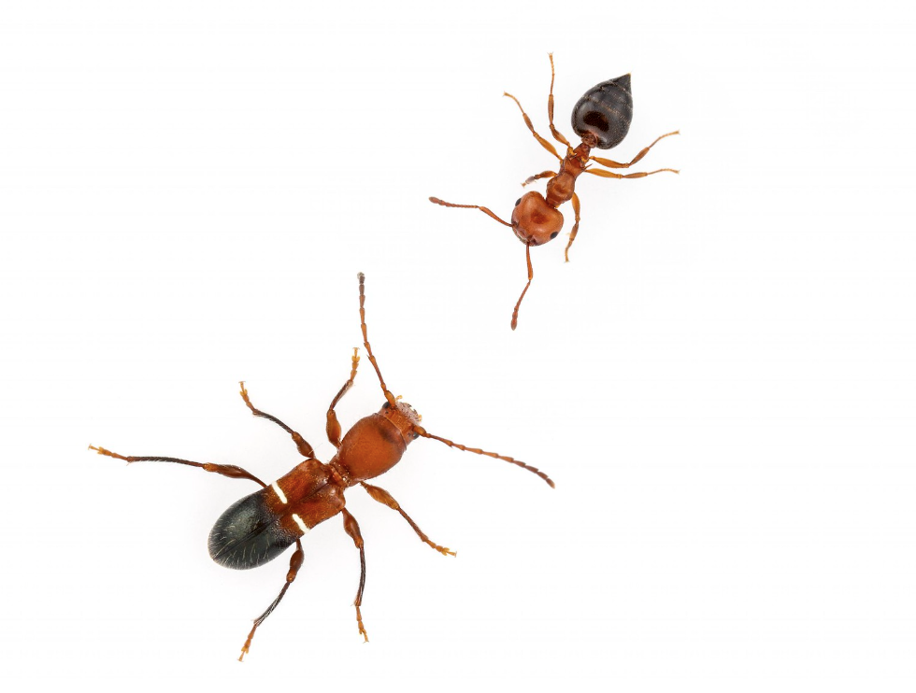
2. Which one is an ant? How can you tell?
A. B.

Slide 8
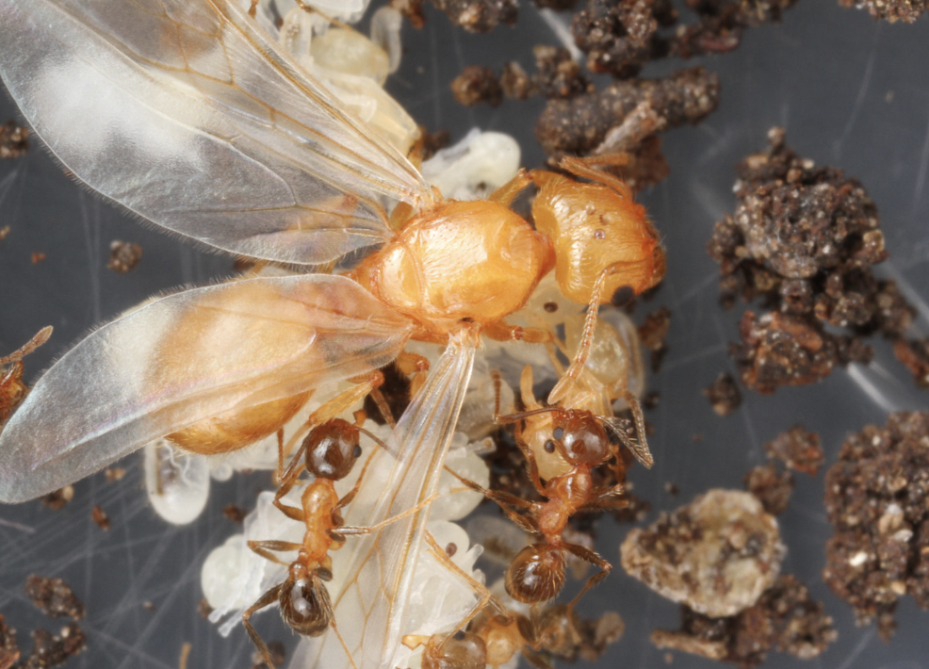
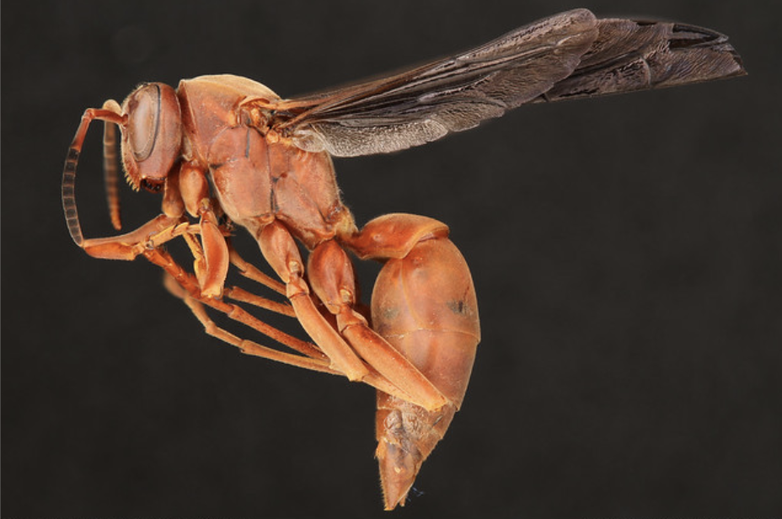
3. Which one is an ant? How can you tell?
A. B.

Slide 9
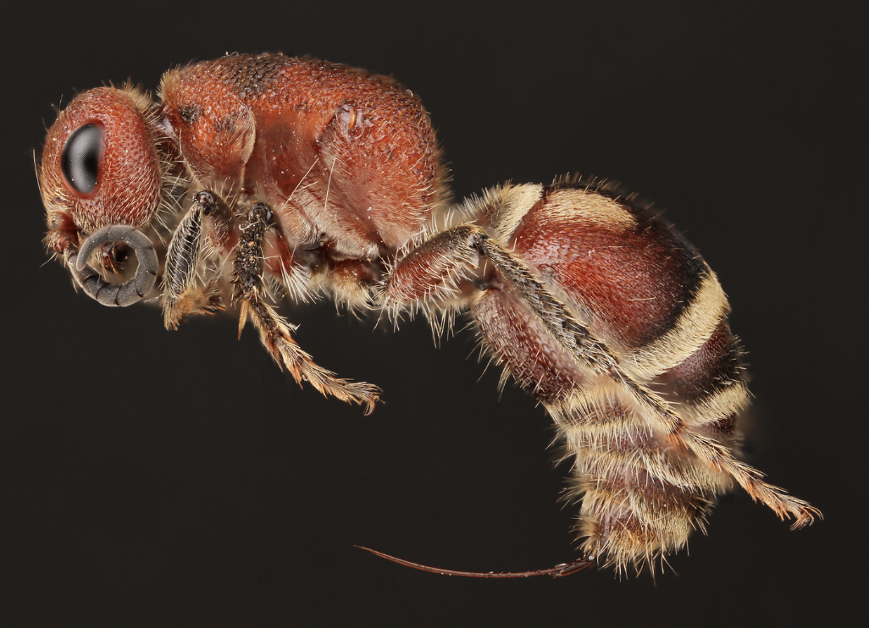
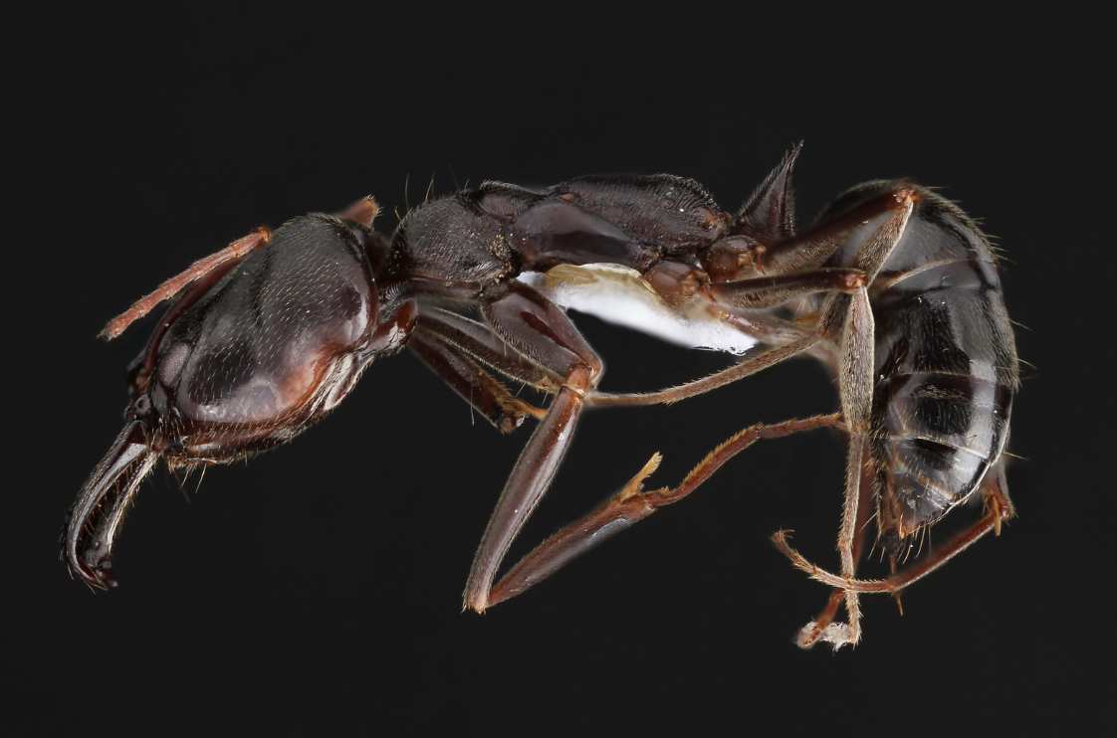
4. Which one is an ant? How can you tell?
A. B.

Slide 10
There are certain traits that are common to ants
and let us identify them.
No wings on workers, queens after mating. Reproductive stages are winged before mating.
Pinched “waist” with 1-2 bumps or nodes
Elbowed antennae

Slide 11
Some traits are common to all insects, including ants.
Three body parts: abdomen, thorax, head
Exoskeleton: skeleton is on the outside of the body
Ventral nerve cord: their “spinal cord” is on their underside
Two compound eyes
Two antennae
Six legs

Slide 12
Let’s look at photos from earlier again.
How can you tell that this is not an ant?

Slide 13
Let’s look at photos from earlier again.
How can you tell that this is not an ant?
Answer: Antennae not elbowed. No pinched waist (the pinched area is too far up the body)

Slide 14
Let’s look at photos from earlier again.
How can you tell that this is not an ant?

Slide 15
Let’s look at photos from earlier again.
How can you tell that this is not an ant?
Answer: no nodes in the pinched waist.
This is a wasp.

Slide 16
Let’s look at photos from earlier again.
How can you tell that this is not an ant?

Slide 17
Let’s look at photos from earlier again.
How can you tell that this is not an ant?
Answer: no node in the pinched waist, antenna not elbowed.
This is a velvet ant, which is actually a wingless wasp.

Slide 18
Let’s look at photos from earlier again.
How can you tell that this is an ant?

Slide 19
Let’s look at photos from earlier again.
How can you tell that this is an ant?
Answer: You can see the node through the wings and the antennae are elbowed.

Slide 20
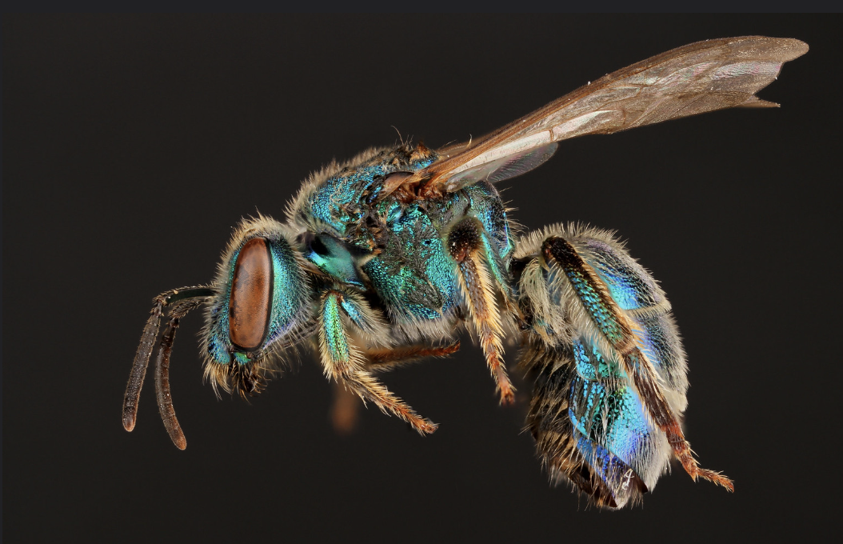
Look closely at these three insects.
Identify three similarities and three differences.

Slide 21
Sweat bee
Harvester Ant
Ants, bees, and wasps are all in a group of insects called Hymenoptera.
Paper wasp

Slide 22
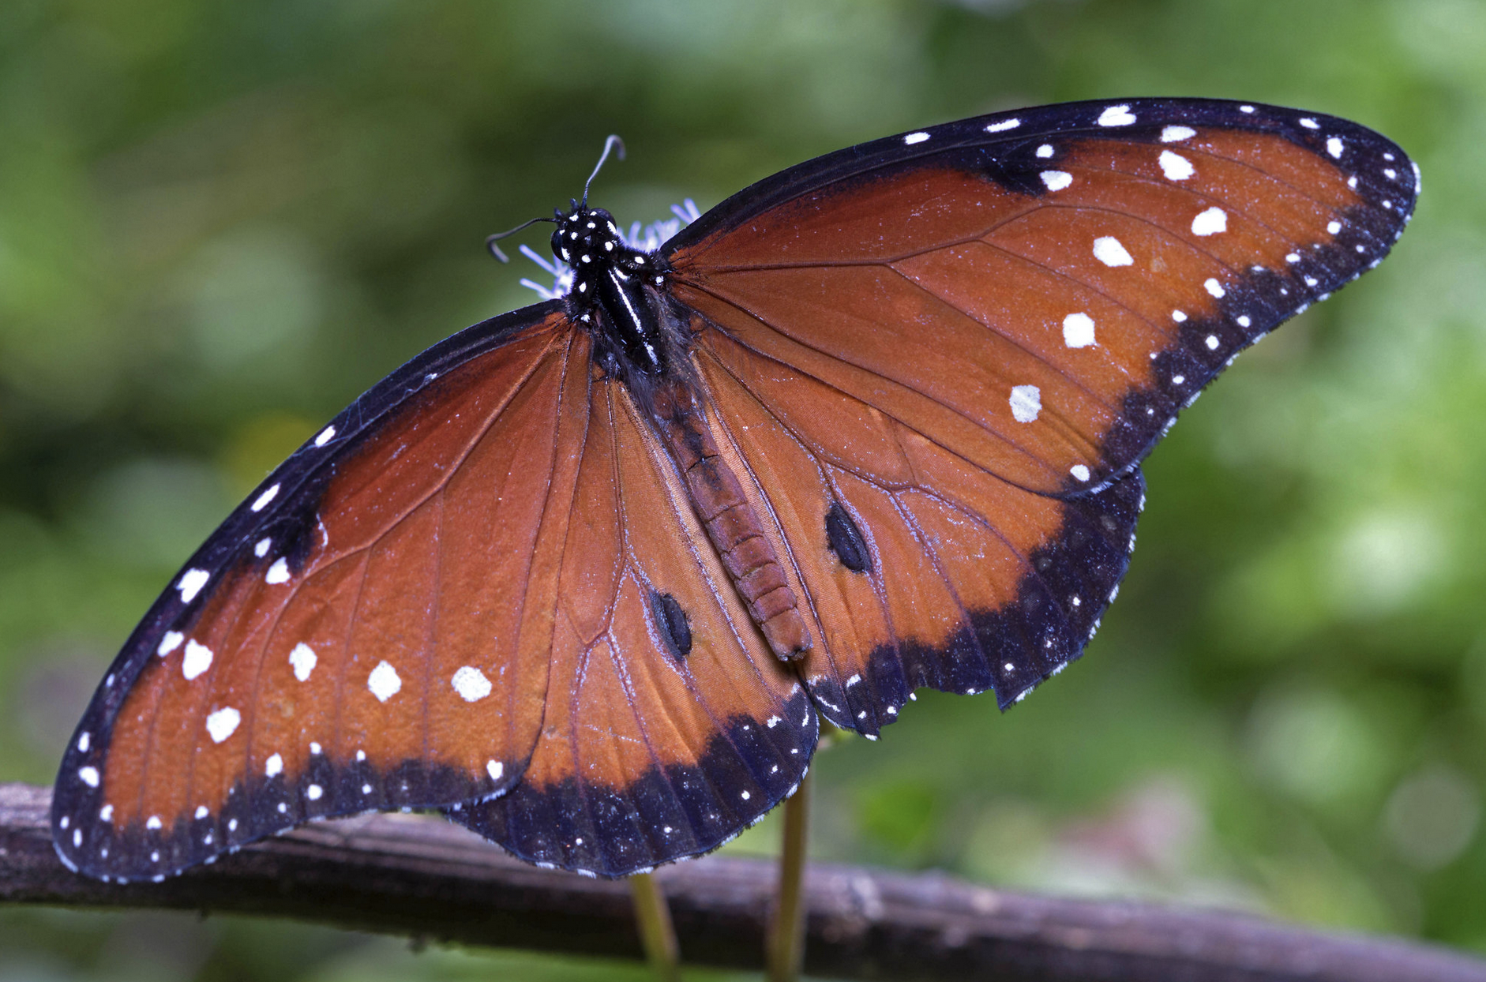
Insect Metamorphosis
Let’s look at Insect Metamorphosis.
Draw and label the lifecycle of a butterfly, starting with an egg.
Image: Public Domain, Insects Unlocked

Slide 23
Vocab
Exoskeleton
Unlike humans, who have their skeletons on the inside of their bodies, insects have exoskeletons, that is, skeletons on the outside of their bodies.

Slide 24
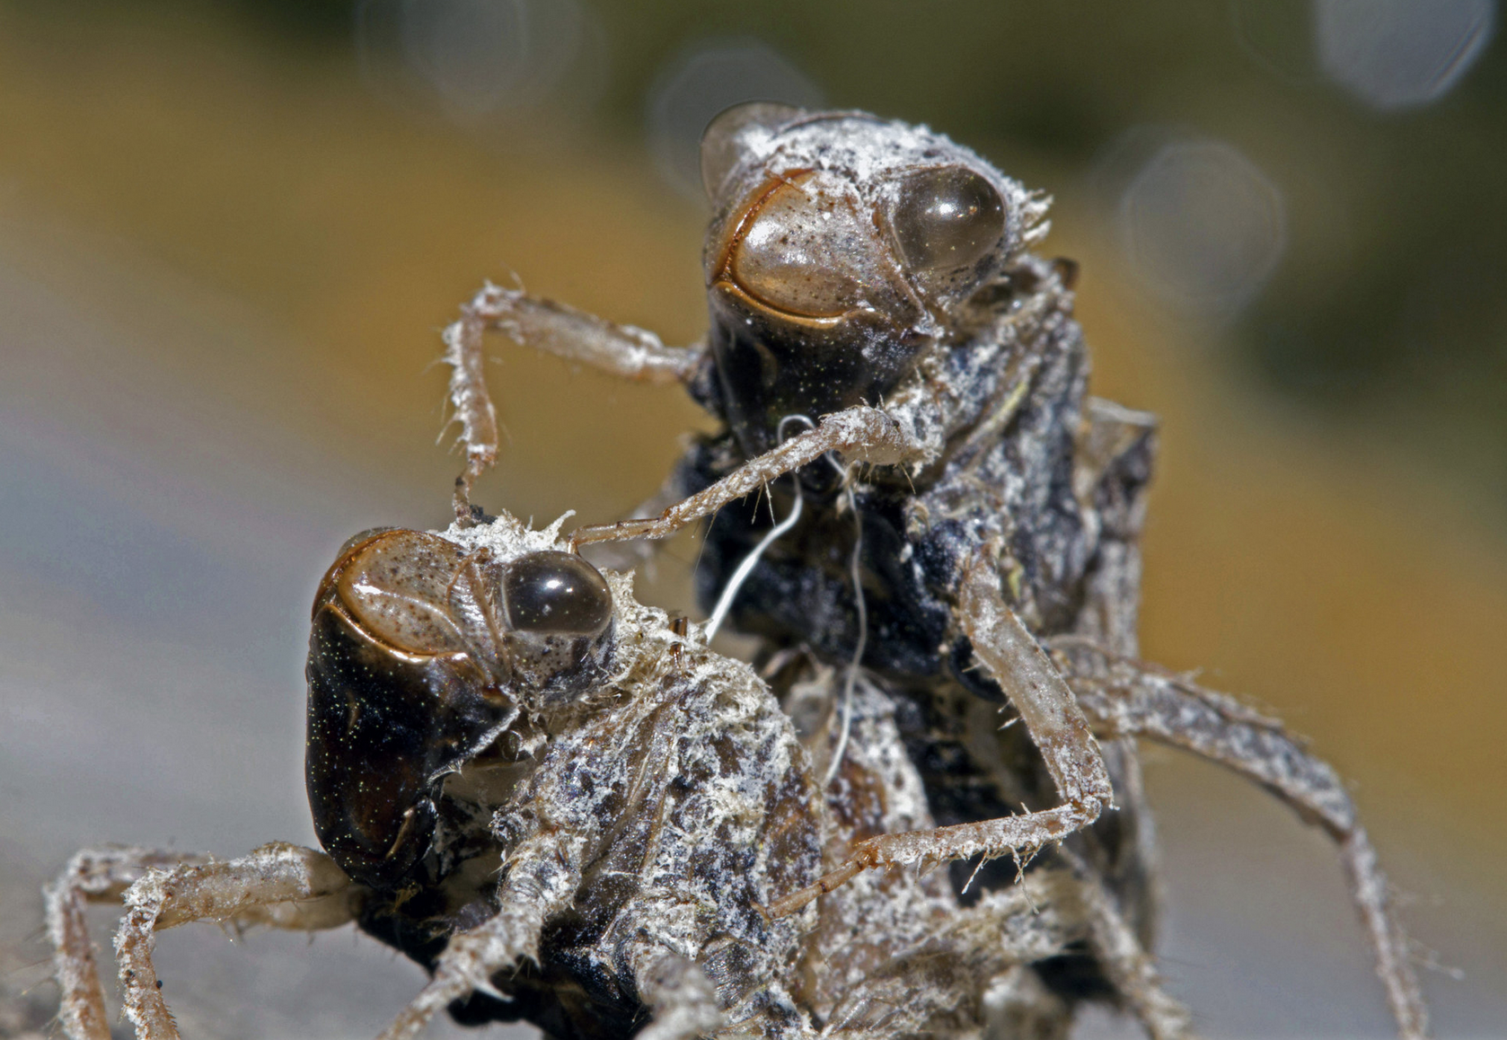
Vocab
Molt
Because insects have their skeleton on the outside of their body (exoskeleton), this limits their ability to grow.
In order to get bigger, an insect has to molt, a process where they shed their exoskeleton (also called shedding their skin).
Image: Public Domain, Insects Unlocked

Slide 25
Vocab
Metamorphosis
Insects change in appearance as they grow from young into adults. This change is called metamorphosis.

Slide 26
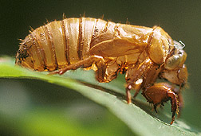
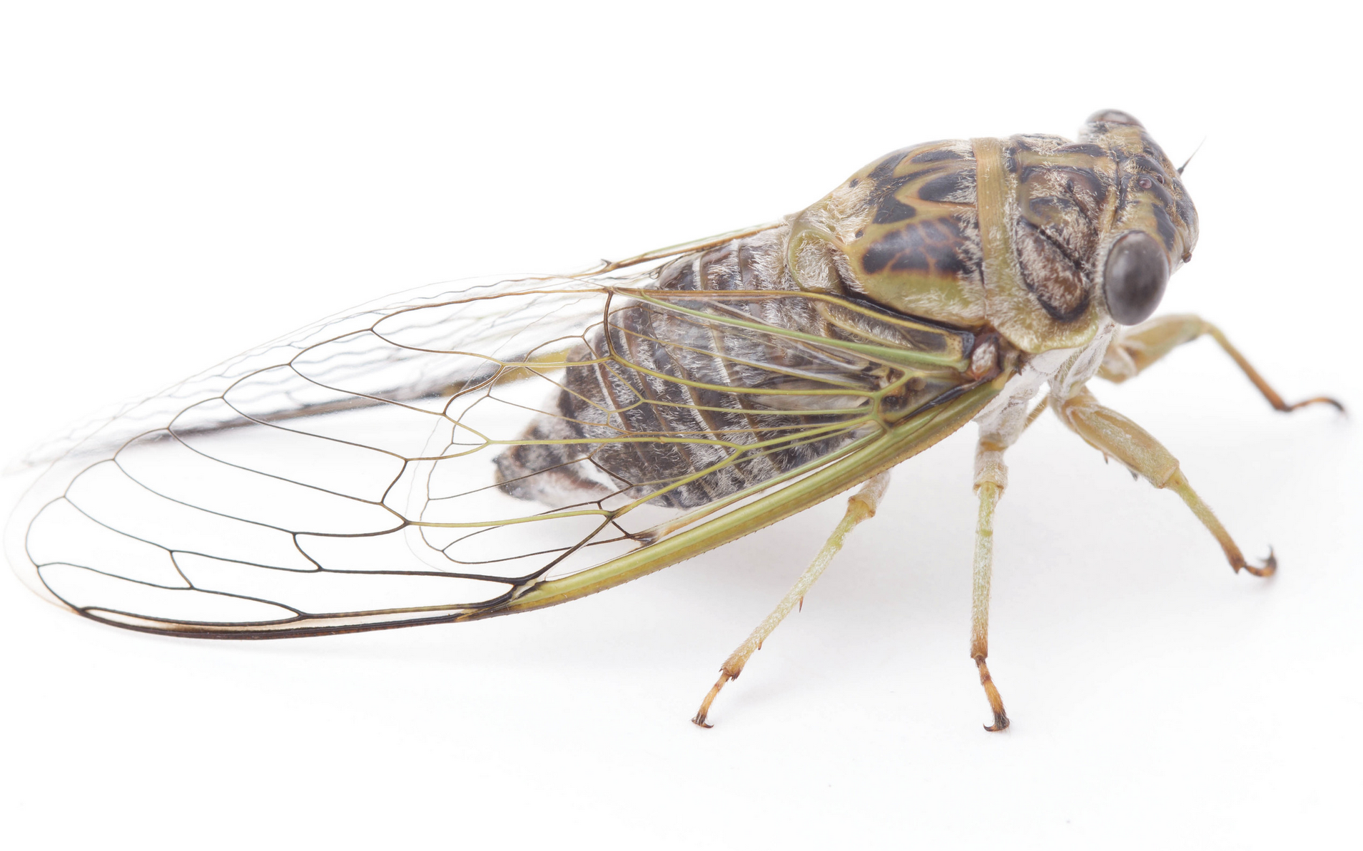
Simple Metamorphosis
nymph
Simple metamorphosis means that their life cycle is egg, nymph, adult.
A nymph is an immature or juvenile insect that looks similar to the adult.
adult
egg
Image: Public Domain, USDA, Insects Unlocked

Slide 27
Vocab
Simple metamorphosis
Insects that go through simple metamorphosis have three stages: egg, nymph, and adults.
Nymph
The immature or young stage of an insect with simple metamorphosis.

Slide 28
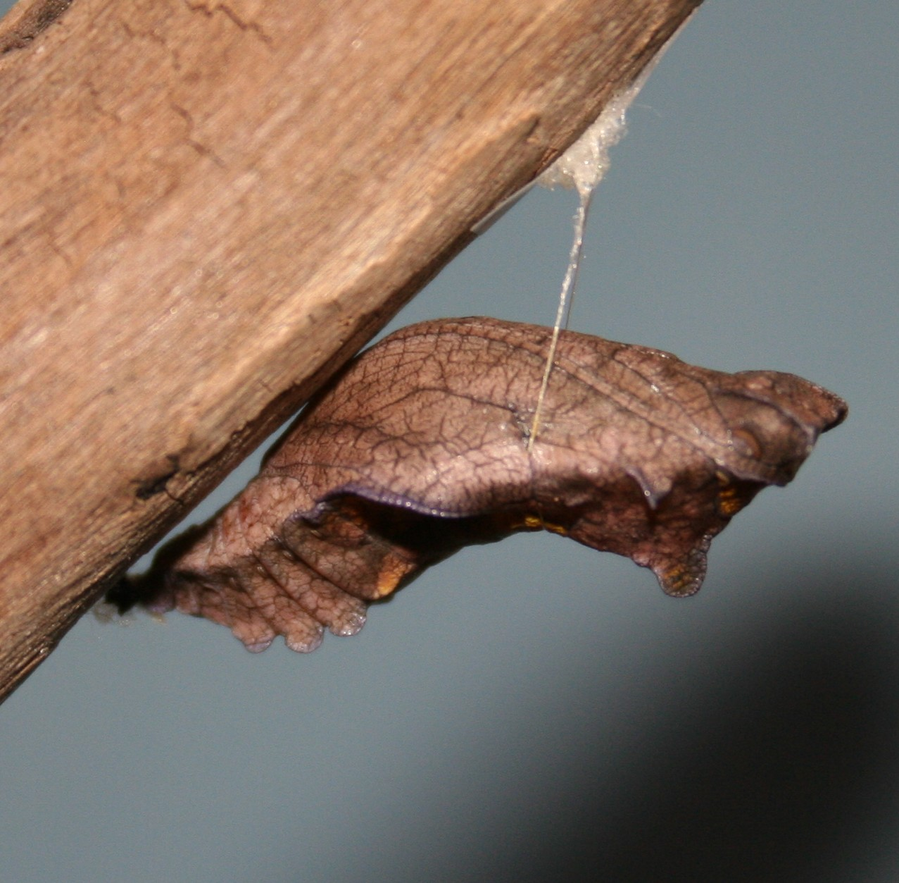
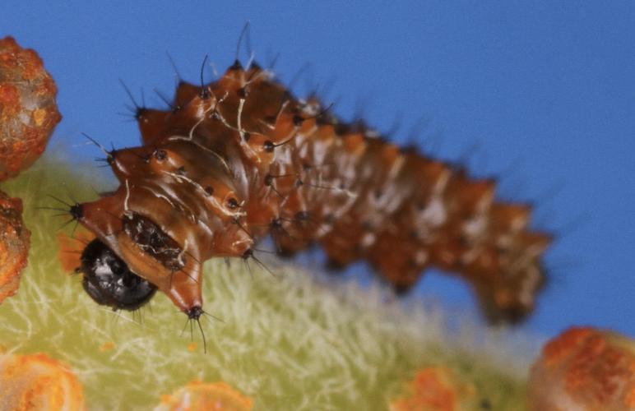
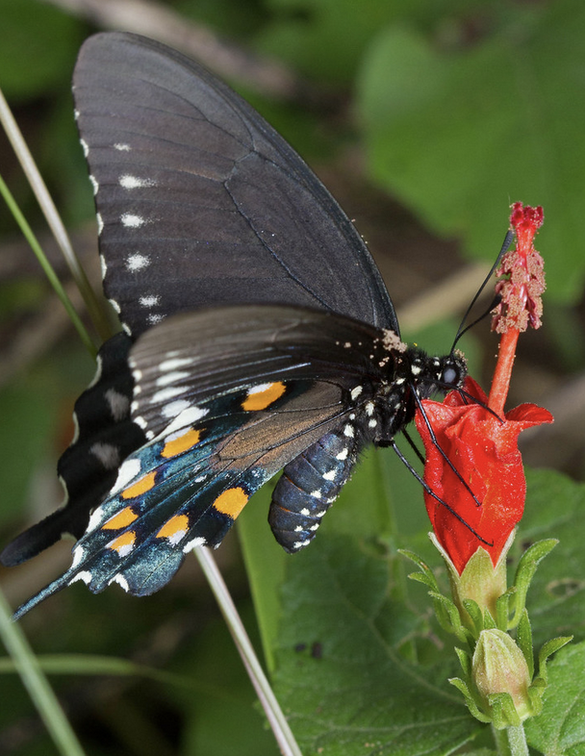
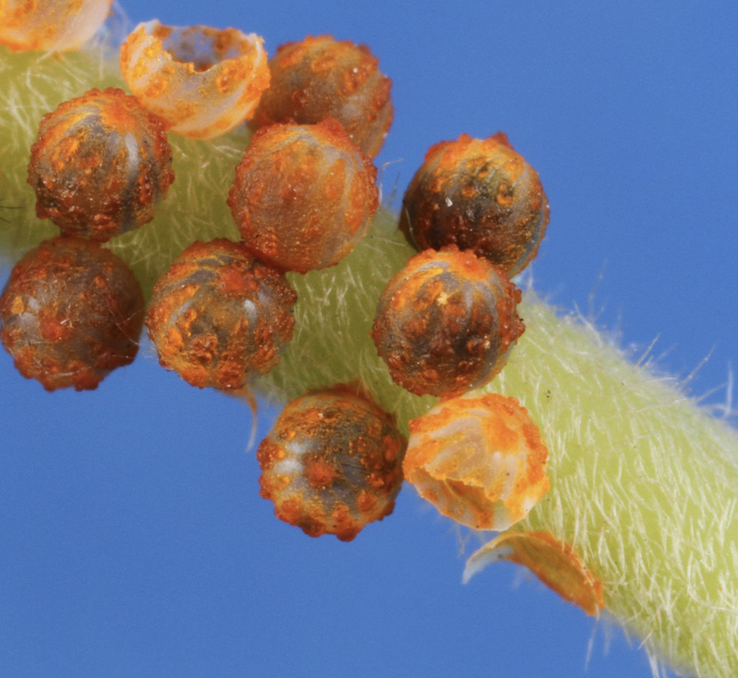
Metamorphosis
Complete metamorphosis means that their life cycle is egg, larva, pupa, adult.
A larva is an immature or juvenile insect that looks worm-like and different from the adult.
pupa
larva
adult
egg
Image: Public Domain, Insects Unlocked, Wikipedia

Slide 29
Vocab
Complete metamorphosis
Insects that go through complete metamorphosis have four stages: egg, larvae, pupae, and adults.
Larva, plural larvae
The immature or young stage of an insect with complete metamorphosis. Often worm-like.
Pupa, plural pupae
The pupa, also known as the cocoon or, in butterflies, the chrysalis, is an inactive stage where the insect’s body changes from larva to adult.

